Slide 1
Business Intelligence and Business Analytics (H9BIBA)

Slide 2

Credits
https://kissflow.com/
https://www.visual-paradigm.com/
https://en.wikipedia.org/
https://tallyfy.com/
https://www.selecthub.com/

Slide 3
Module Content
Intelligent Enterprises
Agile Enterprises, Operating Strategies, Continuous Improvement Programs
Enterprise Systems
Evolution – MRP, CL MRP, MRP II, ERP, ES Packages, Balanced Scorecard
BI and Dashboards
Views v Reports, Types of Dashboards, Advantages of Dashboards, The Funnel
Consumer Behaviour models
Behaviourist v Cognitivist, Lawson’s, EKB, and Howard and Sheth’s models
Operational CRM Systems
Overview and Demo of a commercial system such as Microsoft Dynamics CRM
Implementing Enterprise BI systems
Data Warehousing and Data Marts, Data mining, Online Analytical Process (OLAP)
Implementing CRM systems
Fit-Gap Analysis, Integration with Heterogeneous systems, Data integration, Information Lifecycle Management, Data protection, security and ethical considerations
Customer-Centric Enterprise with CRM
Customer Experience, Customer Loyalty, Customer Relationships, Customer Life Cycle, Customer Value Management
Customer-Responsive Enterprise with SCM
Supply Chain Management, Customer-Responsive Management, B-Webs, Activity Costing techniques
Renewing Enterprise with PLM
Components and Advantages of PLM, Porter’s Framework, Product Life Cycle
Collaborative Enterprise with BPM
BPM, BPR, Business Processes with SOA, Workflows, Analytics
Informed Enterprise with BI
Context-Aware Applications, Decision Patterns and Data mining

Slide 4
Today
Collaborative Enterprise with BPM
BPM, BPR, Business Processes with SOA, Workflows, Analytics

Slide 5

Business Process Management (BPM)
Business Process Management (BPM) is how a company creates, edits, and analyzes the predictable processes that make up the core of its business.
Each department in a company is responsible for taking some raw material or data and transforming it into something else. There may be a dozen or more core processes that each department handles.
With Business Process Management, a company takes a step back and looks at all of these processes in total and individually. It analyzes the current state and identifies areas of improvement to create a more efficient and effective organization.

Slide 6
BPM Continue …
Note: Business process management is neither task management (which focuses on individual tasks) or project management (which handles one-time or unpredictable flows).
Business Process Management is focused more on repetitive and ongoing processes that follow a predictable pattern, or process management.

Slide 7
Why BPM?
When left unorganized and un-systematized, poor business processes can lead to mayhem. At the individual level, people only see one part of a process, and very few can scan out and see the full effects of a process, where it starts and ends, the key data needed, and where potential bottlenecks and inefficiencies lie.
Unmanaged, chaotic processes hurt business and lead to one or more of these scenarios:
Time wasted
More errors
Increased blame
Lack of data
Demoralized employees

Slide 8
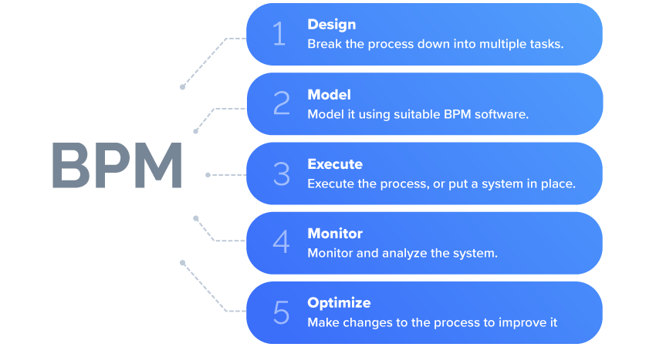
BPM Life Cycle

Slide 9
BPM Steps
Step 1: Design
Most processes include a form to collect data and a workflow to process it. Build your form and identify who will own each task in the workflow.
Step 2: Model
Represent the process in a visual layout. Fix details like deadlines and conditions to give a clear idea of the sequence of events, and the flow of data through the process.
Step 3: Execute
Execute the process by testing it live with a small group first and then open it up to all users. Make sure you restrict access to sensitive information.

Slide 10
BPM Steps
Step 4: Monitor
Keep an eye on the process as it runs through the workflow. Use the right metrics to identify progress, measure efficiency, and locate bottlenecks. Here is a more detailed article about this step.
Step 5: Optimize
As you analyze, notice any changes that need to be done to your form or workflow to make them more efficient. Consider business process improvement steps.

Slide 11
Types of business process management
BPM systems can be categorized based on the purpose that they serve. Three main types of BPM are:
Integration-Centric BPM.
Human-Centric BPM.
Document-Centric BPM.
Most business process management systems will be able to incorporate elements of each of these, but each one will usually have one specialty.

Slide 12
Integration-Centric BPM
This type of business process management system handles processes that primarily jump between your existing systems (e.g. HRMS, CRM, ERP) without much human involvement. Integration-centric business process management systems have extensive connectors and API access to be able to create processes that move fast.

Slide 13
Human-Centric BPM
Human-centric BPM is for those processes that are primarily executed by humans. These often have a lot of approvals and tasks performed by individuals. These platforms excel at a friendly user interface, easy notifications, and quick tracking.

Slide 14
Document-Centric BPM
These business process management solutions are required when a document (e.g. a contract or agreement) is at the heart of the process. They enable routing, formatting, verifying, and getting the document signed as the tasks pass along the workflow.

Slide 15
What are the benefits of incorporating business process management?
Gain control of chaotic and unwieldy processes
Create, map, analyze, and improve business processes
Run everyday operations more efficiently
Realize bigger organizational goals
Move toward digital transformation
Improve and optimize tangled operations
Closely track individual items as they move through a workflow

Slide 16
MPM examples
HR: Have you ever felt your organization’s onboarding process is too complex and chaotic? Is your HR department asking the candidates to fill out paper forms that make them exhausted? This is because your HR department lacks the principle of Business Process Management (BPM). Applying business process management, helps you automate your HR processes end-to-end, thereby cutting down on cost, time, and paper forms. Given below are a couple of examples as to how business process management helps your HR department to improve their processes:
Approve employee timesheets faster
Onboard new hires without hassles

Slide 17
MPM examples continue …
Sales: In most organizations, the sales team spends a significant amount of time in coordinating with the Accounts Receivable (AR) team, to get sales invoices approved. Even a small typo in invoices, ruins the lives of the salespeople. This is where business process management comes into the picture, since it automates the invoice approval process, thereby eliminating the chances of manual errors and the back and forth clarifications between the salespeople and the AR team. Given below are a couple of scenarios in the sales department, where business process management can help them streamline their processes:
Shorten your sales cycle workflows
Be on time with quotes and invoices

Slide 18
MPM examples continue …
Finance: Finance team is the one that is bombarded with paper forms and emails every day, since anything that involves money has to go through them. For instance, if the asset management team wants to purchase 50 laptops, they send the quotation that they received from the vendor to the finance team, for them to approve it. This is just one case. Imagine, how many such emails or paper forms they would be receiving on a daily basis from various teams. Without a system in place, it’ll be cumbersome for them to manage all of these. The one that helps them manage these processes is essentially the business process management (BPM) system. Given below are a couple of scenarios in the finance department, where business process management comes as a saving grace:
One-click approvals for travel requests
Customize workflows for unique scenarios

Slide 19
Popular 5 BPM Software
Brand Name | Popular With | Process Design | Operational Ease | Pricing | Support
Nintex | SMBs, enterprise | Browser-based intuitive design | On-prem | By quote | None (open-sourced)
Process Maker | Corporations, governments, and organizations looking for an enterprise scale | BPMN 2.0 | Different editions of on-prem and cloud | Starts at $1000/month (unlimited users) | Video documentation, email, webinars, instant chat
Kissflow | SMBs, mid-market | Human-centric drag and drop interface | Cloud-based | Starts at $390, 4.3/5 – 445 (Votes) Learn more. | Video documentation, email, webinars, instant chat
Bizagi | SMBs, medium businesses, enterprises | Bizagi BPMN Modeler | Cloud hosted/on-prem | Perpetual user license for $800/year+$134 maintenance fee (or) 1-year user license for $311/year | Basic for free (with no SLAs) or premium support at an extra cost
Zoho Creator | Freelancers, small- and mid-size businesses, and enterprise | Script builder to drag and drop snippets of code | Web-based, on prem, or can be self-hosted | $5-$15/user/month (depending on license plans) | Email, phone, training, ticket escalation

Slide 20

Business process re-engineering (BPR)
Business process re-engineering (BPR) is a business management strategy, aimed to help organizations fundamentally rethink how they do their work in order to improve customer service, cut operational costs, and become world-class competitors.
Focuses on the analysis and design of workflows and business processes within an organization.
BPR involves discovering how business processes currently operate, how to redesign these processes to eliminate the wasted or redundant effort and improve efficiency, and how to implement the process changes to gain competitiveness.
Business process reengineering is the act of recreating a core business process with the goal of improving product output, quality, or reducing costs.

Slide 21
Business Process Reengineering Steps
Identity and Communicating the Need for Change
Put Together a Team of Experts
Find the Inefficient Processes and Define Key Performance Indicators (KPI)
Reengineer the Processes and Compare KPIs

Slide 22
Identity and Communicating the Need for Change
There will always be individuals who are happy with things as they are, both from the side of management and employees. The first might be afraid that it might be a sunk investment, the later for their job security.
So, you’ll need to convince them why making the change is essential for the company. If the company is not doing well, this shouldn’t be too hard.
In some cases, however, the issue is with the company not doing as well as it could be. Meaning, you should do your research. Which processes might not be working? Is your competition doing better than you in some regards? Worse?
Once you have all the information, you’ll need to come up with a very comprehensive plan, involving leaders from different departments. The management will have to play the role of salespeople: conveying the grand vision of change, showing how it’ll affect even the lowest-ranked employee positively.

Slide 23
Put Together a Team of Experts
As with any other project, business process reengineering needs a team of highly skilled, motivated people who will carry out the needed steps.
In most cases, the team consists of:
Senior Manager. When it comes to making a major change, you need the supervision of someone who can call the shots. If a BPR team doesn’t have someone from the senior management, they’ll have to get in touch with them for every minor change.
Operational Manager. As a given, you’ll need someone who knows the ins-and-outs of the process – and that’s where the operational manager comes in. They’ve worked with the process(es) and can contribute with their vast knowledge.
Reengineering Experts. Finally, you’ll need the right engineers. Reengineering processes might need expertise from a number of different fields, anything from IT to manufacturing. While it usually varies case by case, the right change might be anything – hardware, software, workflows, etc.

Slide 24
Find the Inefficient Processes and Define Key Performance Indicators (KPI)
Once you have the team ready and about to kick-off the initiative, you’ll need to define the right KPIs. You don’t want to adapt to a new process and THEN realize that you didn’t keep some expenses in mind – the idea of BPR is to optimize, not the other way around.
While KPIs usually vary depending on what process you’re optimizing, the following can be very typical:
Manufacturing
Cycle Time – The time spent from the beginning to the end of a process
Changeover Time – Time needed to switch the line from making one product to the next
Defect Rate – Percentage of products manufactured defective
Inventory Turnover – How long it takes for the manufacturing line to turn inventory into products
Planned VS Emergency Maintenance – The ratio of the times planned maintenance and emergency maintenance happen
IT
Mean Time to Repair – Average time needed to repair the system / software / app after an emergency
Support Ticket Closure rate – Number of support tickets closed by the support team divided by the number opened
Application Dev. – The time needed to fully develop a new application from scratch
Cycle Time – The time needed to get the network back up after a security breach

Slide 25
Reengineer the Processes and Compare KPIs
Finally, once you’re done with all the analysis and planning, you can start implementing the solutions and changes on a small scale.
Once you get to this point, there’s not much to add – what you have to do now is keep putting your theories into practice and seeing how the KPIs hold up.
If the KPIs show that the new solution works better, you can start slowly scaling the solution, putting it into action within more and more company processes.
If not, you go back to the drawing board and start chalking up new potential solutions.

Slide 26
BPR Example (Ford Motors)
One of the most referenced business process reengineering examples is the case of Ford, an automobile manufacturing company.
In the 1980s, the American automobile industry was in a depression, and in an attempt to cut costs, Ford decided to scrutinize some of their departments in an attempt to find inefficient processes.
One of their findings was that the accounts payable department was not as efficient as it could be: their accounts payable division consisted of 500 people, as opposed to Mazda’s (their partner) 5.

Slide 27
BPR Example (Ford Motors) continue …
While Mazda was a smaller company, Ford estimated that their department was still 5 times bigger than it should have been.
Accordingly, Ford management set themselves a quantifiable goal: to reduce the number of clerks working in accounts payable by a couple of hundred employees. Then, they launched a business process reengineering initiative to figure out why was the department so overstaffed.

Slide 28
BPR Example (Ford Motors) continue …
They analyzed the current system, and found out that it worked as follows:
When the purchasing department would write a purchase order, they sent a copy to accounts payable.
Then, the material control would receive the goods, and send a copy of the related document to accounts payable.
At the same time, the vendor would send a receipt for the goods to accounts payable.
Then, the clerk at the accounts payable department would have to match the three orders, and if they matched, he or she would issue the payment. This, of course, took a lot of manpower in the department.

Slide 29
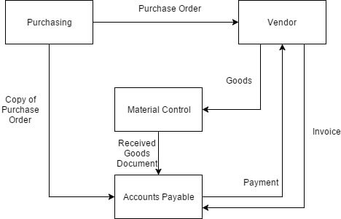
So, as is the case with BPR, Ford completely recreated the process digitally. 1. Purchasing issues an order and inputs it into an online database. 2. Material control receives the goods and cross-references with the database to make sure it matches an order. 3. If there’s a match, material control accepts the order on the computer.

Slide 30
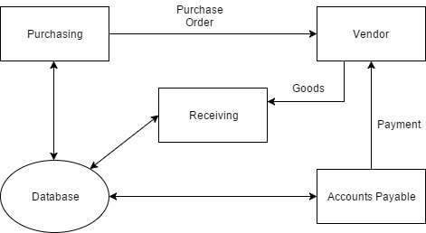
This way, the need for accounts payable clerks to match the orders was completely eliminated.

Slide 31
Workflow
A Workflow is a sequence of tasks that processes a set of data. Workflows occur across every kind of business and industry. Anytime data is passed between humans and/or systems, a workflow is created. Workflows are the paths that describe how something goes from being undone to done, or raw to processed.

Slide 32
Workflow Types
Workflows happen throughout the workspace. Some are very structured, and others are unstructured, but workflows exist anytime data moves from one task to another.
Here are three major types of workflow:
Process Workflow
Case Workflow
Project Workflow

Slide 33

Process Workflow
A process workflow happens when the set of tasks is predictable and repetitive. This means that before an item begins the workflow, you know exactly what path it should take.
Business process workflows are set up to handle an unlimited number of items going through them. An example is a purchase requisition approval workflow. As soon as it starts, the workflow is set with few variations, and you can process any number of items in a single workflow.

Slide 34
Case Workflow
In a case workflow, you don’t know the path required to complete the item at the start. The path reveals itself as more data is gathered. Support tickets and insurance claims are good examples of cases. It’s not clear right from the start how these items will be processed; only after some investigation will the path reveal itself.
Similar to process workflows, case workflows can handle any number of items, although they are dependent on a human or an intelligent bot to discern the right path.

Slide 35
Project Workflow
Projects have a structured path similar to processes, but there may be more flexibility along the way. Think about releasing a new version of your website. You can predict with good accuracy the sequence of tasks required to complete the project.
However, project workflow is only good for one item. Another website release may not be done for a long time and will not likely follow exactly the same path.
Most resources you’ll find online will only refer to workflows in the sense of process workflow, but the other two are just as important to consider as much of the work around the office falls into those two categories.

Slide 36
How Can I Spot Workflows Around Me?
Workflows hide in many places. If you have a lot of emails you mindlessly pass down an invisible chain, that’s a workflow. If you print the same form over and over again, that’s a workflow.
If you find yourself turning to a spreadsheet to organize dynamic data, that’s a workflow. If you find your work is getting held up because someone else isn’t doing their job well, that’s a workflow.
Here’s an example of an employee onboarding workflow.

Slide 37
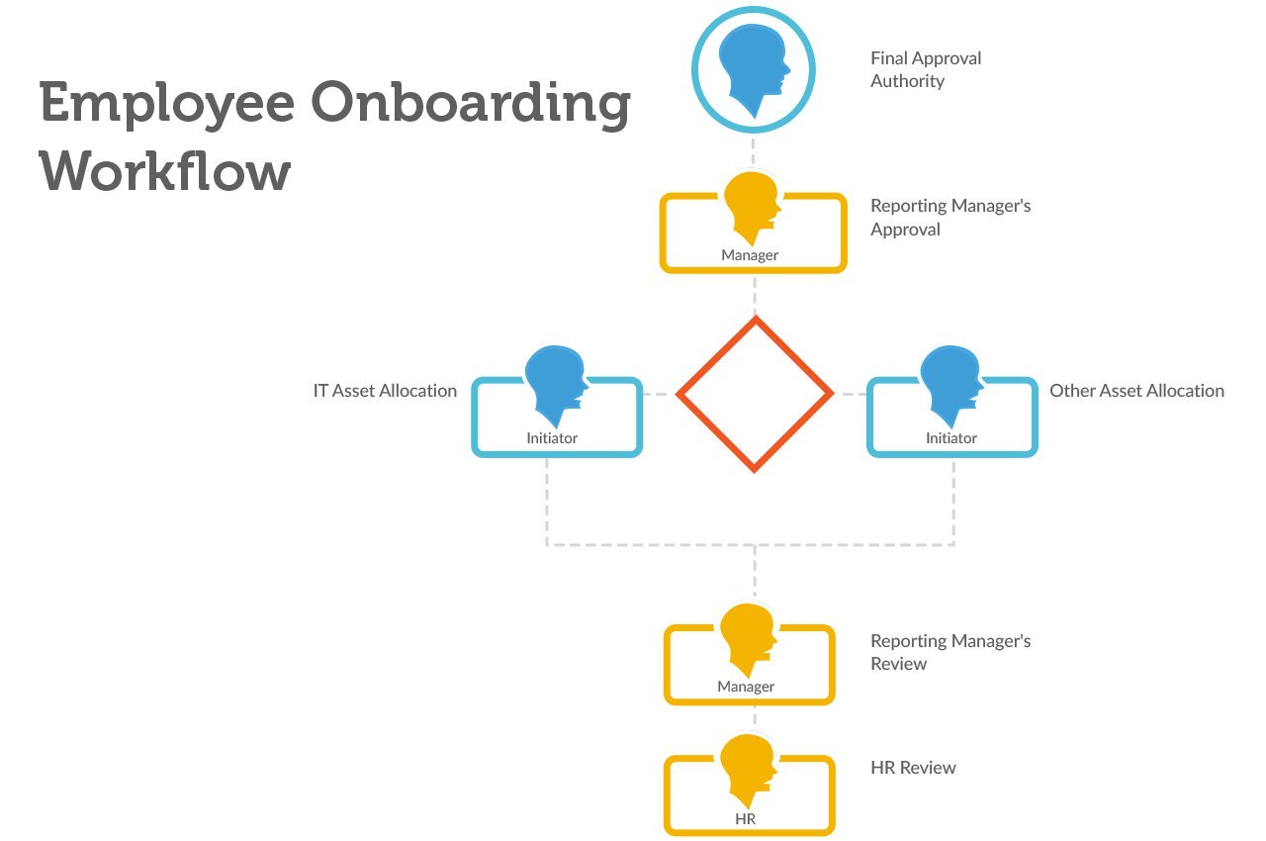

Slide 38
Are Workflows and Processes the Same Thing?
No. Workflows only describe the sequence of tasks. A process is a broader term that also encompasses the data, forms, reports, and notifications required to get an item from start to finish in a structured environment.
For example, the workflow for purchase orders might be Initiator => Manager Approval => Procurement Processing. But the process also involves a data set of approved vendors to choose from, the individual sequential number assigned to the purchase order, how procurement is notified, the budget available, and many more factors. Learn more about workflow vs process.

Slide 39
Human-Centric vs. System-Centric Workflows
In human-centric workflows, most of the tasks are assigned to humans. These might require approving data, creating something new, or double-checking information.
In system-centric workflows, most of the tasks are done by a machine and require little to no human involvement. For example, to create a financial report, a workflow might be triggered at the same time every month to grab certain data from different systems, parse it into a report, and email the report to all the stakeholders. A system can perform all of these tasks.

Slide 40
Automated vs. Manual Workflows
In a manual workflow, a human is responsible for pushing each item from one task to another. For example, when an employee fills out a reimbursement claim, she must email it to her manager for approval. After approval, she must email it to the finance department.
The finance department must go into the software and schedule a payment and then email the employee to say it is complete.
In an automated workflow, when a human completes a task, she is not responsible for passing the data on to the next task. The workflow is programmed to handle this. The system manages the flow of tasks including notifications, deadlines, and reminders.

Slide 41
Business Analytics (BA)
BA collects and analyzes data, employs predictive analytics, and generates richly visualized reports in custom dashboards. The aim of these features is to help identify and address an organization’s weak points. This is where the similarities end. Business analytics software is used to explore and analyze historical and current data. It utilizes statistical analysis, data mining and quantitative analysis to identify past business trends.
Once data has been collected and analyzed, Business intelligence analytics systems then use that data for predictive modeling. This can predict and, in most cases, prepare for future business climates. One of the most powerful aspects of BA is ad-hoc reporting, which allows companies to perform analysis of specified data in real-time to answer targeted questions to make quicker business decisions. In effect, business analytics uses predictive analysis to solve problems before they’ve occurred.

Slide 42
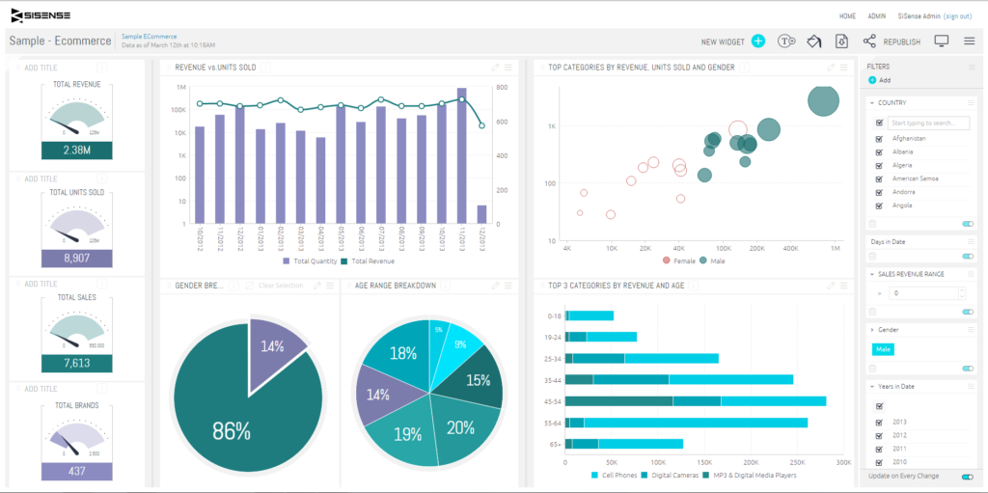
A business analytics dashboard from Sisense.

Slide 43

Thank you!

